Slide 1



Sustainable Supply Chain Performance in PowerBI

Slide 2

Learn functioning of PowerBI
Analyzing supplier’s and manufacturer’s performance
Explore various Visualization Techniques
Build interactive Dashboards
Understanding key Supply Chain metrics
Learning Objectives
GOAL
Source :
www.freepik.com/

Slide 3




Tools and Technology used
Excel / CSV -
Data storage, pre-processing, and integration with Power BI.
Power BI – Data visualization, dashboard creation, and real-time analytics
Power Query – Data transformation, cleaning, and ETL (Extract, Transform, Load) operations.
DAX (Data Analysis Expressions) – Custom calculations and measures in Power BI.

Slide 4
Methodology
Define the Objective
Learn basics of PowerBI
Preprocess and Transform Data (if required)
Exploratory Data Analysis(EDA)
Use basic Visuals
Compare performance of distinct categorical values
Use advanced features like Matrix, DAX for better insights
Generate Auto-inferences by Copilot

Slide 5
Problem Statement:
The modern supply chain faces critical challenges in balancing cost efficiency, operational performance, and environmental sustainability. Companies struggle with:
High Transportation Costs– Inefficient routes and reliance on high-emission transport modes (Air, Road).
Supplier & Manufacturing Inefficiencies – Long lead times, high defect rates, and production delays impacting sustainability.
Inventory & Demand Mismatch – Overstocking or understocking leading to financial loss and resource wastage.
Inspection & Quality Control Failures – Increased rework, waste, and customer dissatisfaction.
Lack of Data-Driven Insights – Inability to track and optimize supply chain sustainability metrics.

Slide 6
Solution:
1. Improved Data Tracking & Organization
--> Standardize data collection across all weeks to maintain consistency. --> Introduce automated dashboards (e.g., Power BI, Tableau) for real-time tracking. --> Segment data into "Revenue," "Shipments," "Customer Demographics," and "Logistics" for clearer insights.
2. Revenue Growth & Efficiency Optimization
--> Focus on top-performing suppliers & SKUs (e.g., highest revenue generators). --> Reduce dependency on low-performing suppliers or negotiate better deals. --> Optimize inventory levels based on sales trends to reduce overstock or shortages.
5. SKU & Product Optimization
--> Expand product categories that show higher sales growth (e.g., skincare & cosmetics). --> Reduce investment in slow-moving SKUs while testing new variants. --> Introduce customer feedback mechanisms to identify trending products faster.

Slide 7
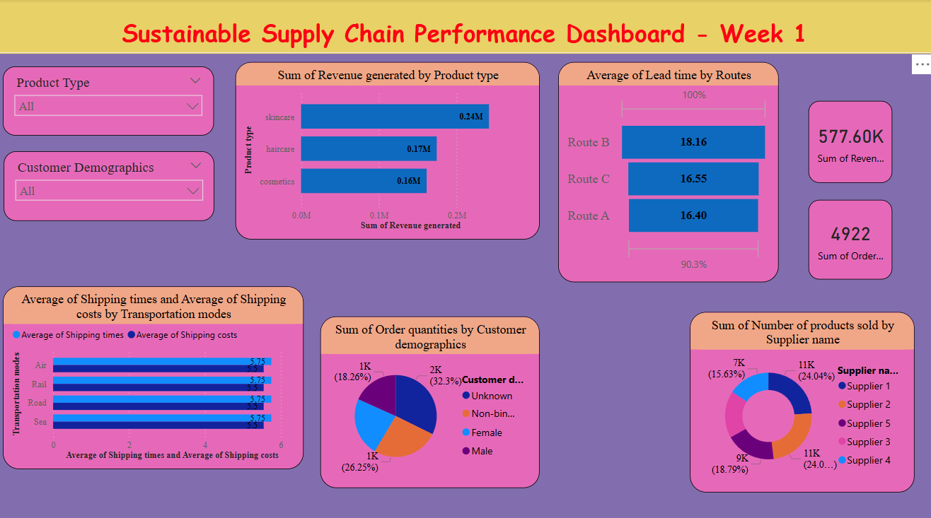
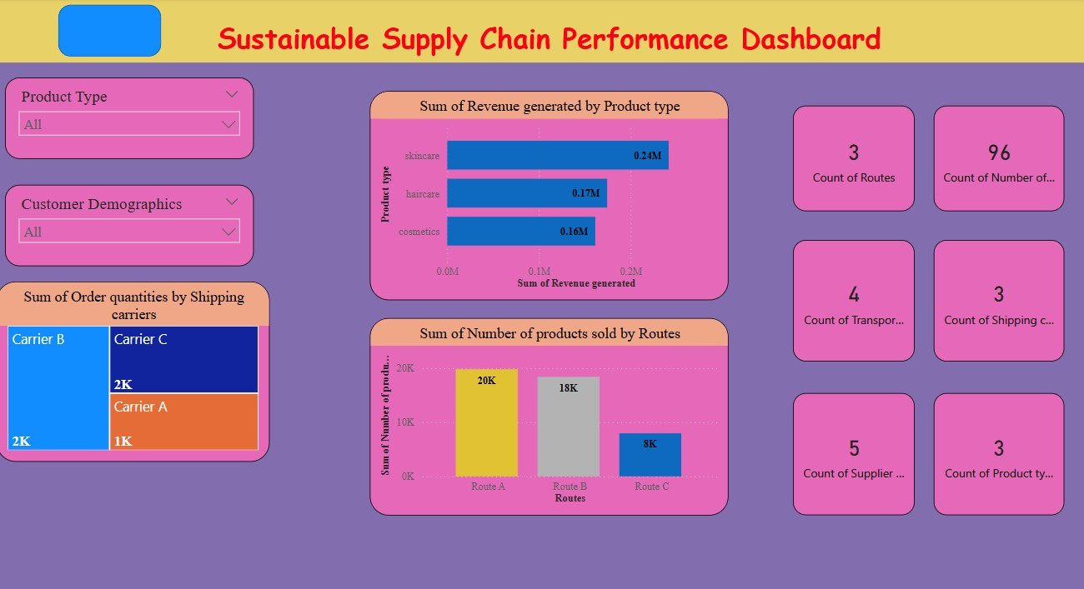
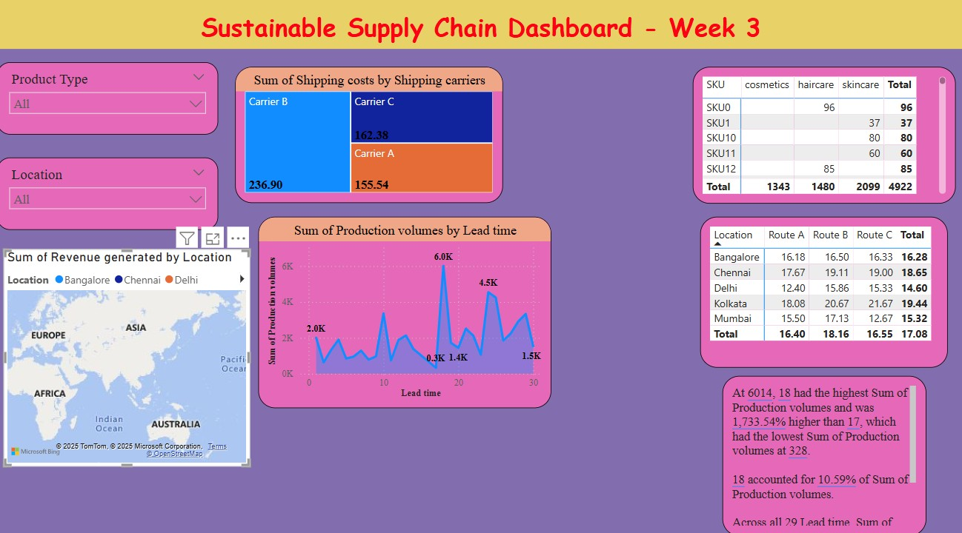
Screenshot of Output:
Visit this Github link for better visualization – https://github.com/SamyakDahale/Supply-Chain-Dashboard-using-powerBI

Slide 8
Conclusion:
There are multiple suppliers, with Supplier 1 and Supplier 5 appearing prominent in terms of sale
SkinCare products were the highest selling type.
Breakdown of revenue by locations: Bangalore, Chennai, Delhi, Kolkata, and Mumbai. Mumbai gave the highest gross revenue.
Production volumes are tracked, showing a significant difference between the highest and lowest production figures.
Roadways emerged as the primary mode of transportation, followed by seaways.
The average lead time for delivery stands at 14.77 days.
Total Revenue from all products stands at 5,77,600.

